Slide 1


INTERNSHIP PRESENTATION
Start date: 1st July 2026
End date: 30th August 2026
A Client-Side Digital Internship Management System for Digitalizing Intern Registration, Attendance Tracking, Supervisor Assignment, and Performance Reporting(INTERNFLOW)
Presented By Ngene Brandon | Ngefor Marion | Nchang Vigiline
Organization & Dept. PRESPRINT PLC | PDL Department
Supervisor Mr. Djama Vincent Joel
Date: 21st August 2026

Slide 2


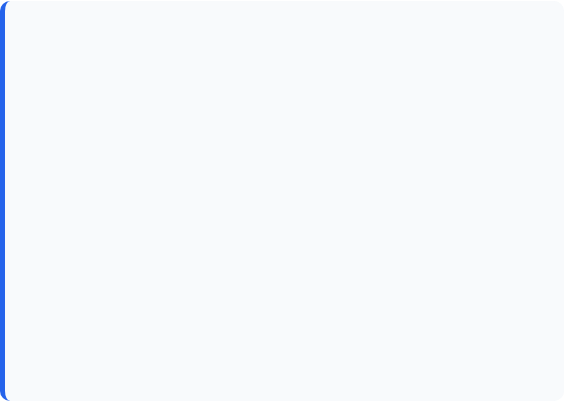
The Challenge at PRESPRINT PLC
Key Operational Risks
Manual Operational Friction
Manual methods introduce severe administrative vulnerabilities and inefficiencies:
Internship tracking at PRESPRINT PLC currently relies entirely on manual, paper-based workflows:
•
Error Prone: Physical records suffer from handwriting inaccuracies and risk of loss/damage.
•
Interns fill manual paper registration forms upon onboarding.
•
Slow Retrieval: Searching historic logs takes substantial time and effort.
•
Daily attendance is recorded in physical attendance logbooks.
•
Poor Monitoring: Difficulty evaluating attendance trends and overall intern performance.
•
Supervisor assignments are communicated verbally, leading to mix-ups.
2

Slide 3
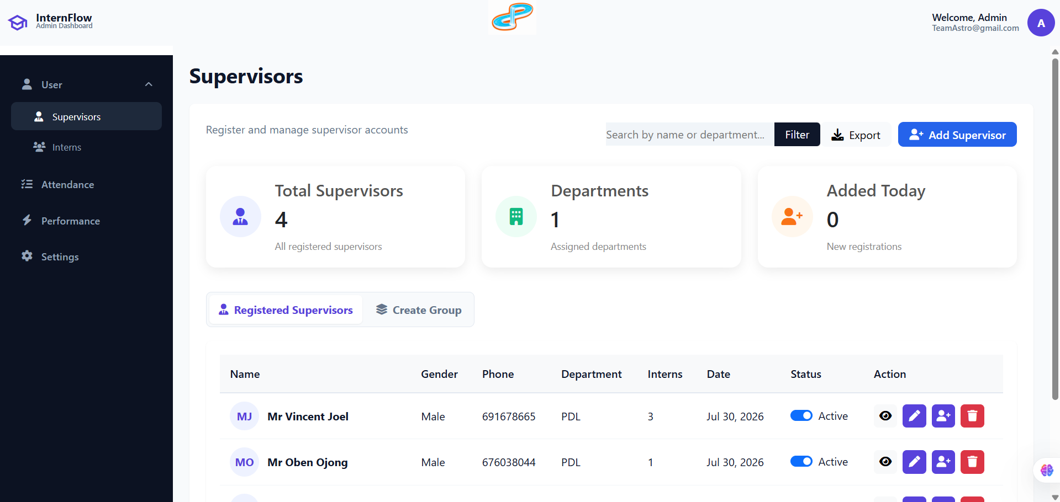

Proposed Solution: InternFlow
Centralized Digital Ecosystem
InternFlow replaces Manual paper workflows with an Automated digital platform designed to Facilitate core internship activities:
•
Digital Registration: Instant intern profile setup and automated credential generation.
•
Attendance Tracking: Real-time clock-in/out logging with status categorization.
•
Supervisor Assignment: Structured grouping and clear supervisor allocation.
•
Performance Reporting: Automated evaluation scoring and printable reports.
3

Slide 4






Core Technology Stack
HTML5 & CSS
JavaScript & IndexedDB
UML & Jira
Provides Backbone Structure and modern responsive styling. Custom layouts ensure clean navigation across login, intern, supervisor, attendance, and reporting pages.
Powers client-side application logic and uses browser-native IndexedDB for high-performance, offline-capable database storage without expensive backend servers.
System architecture designed using Unified Modeling Language (Use Cases, Class/ERD). Task allocation and sprint scheduling managed systematically via Jira.
Git & GitHub
Claude.ai
Provides virtual storage and space for collaboration within our team and synchronizes our workflow with simple Git commands
Helped with debugging code and explanation of complex functions
4

Slide 5
System Functional Architecture
Intern Registration Module: Standard users and Admins register, list, update, view details, and delete intern records smoothly.
Supervisor Management Module: Admin creates supervisors, defines roles, creates groups, and maps interns to designated supervisors.
Attendance Tracking Module: Automated daily attendance clock-in, historical attendance listing, and status filter for administrators.
Performance Reporting Module: Input evaluation scores, calculate cumulative performance metrics, and generate printable summary cards.
5

Slide 6
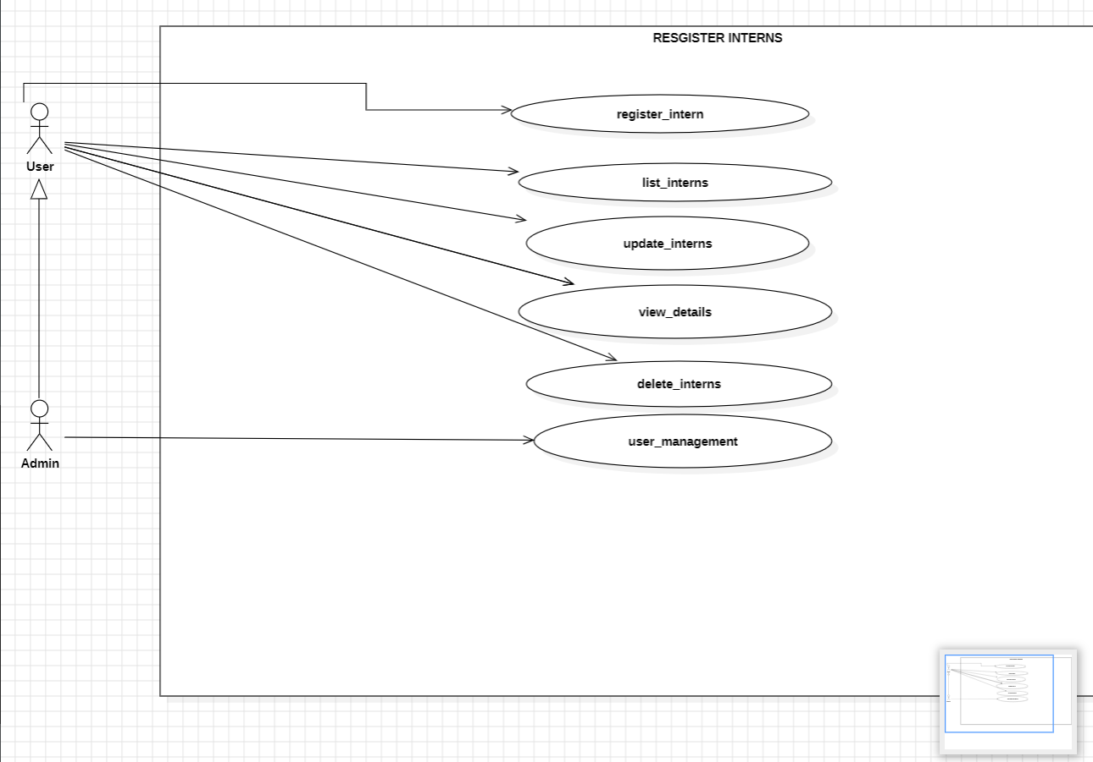
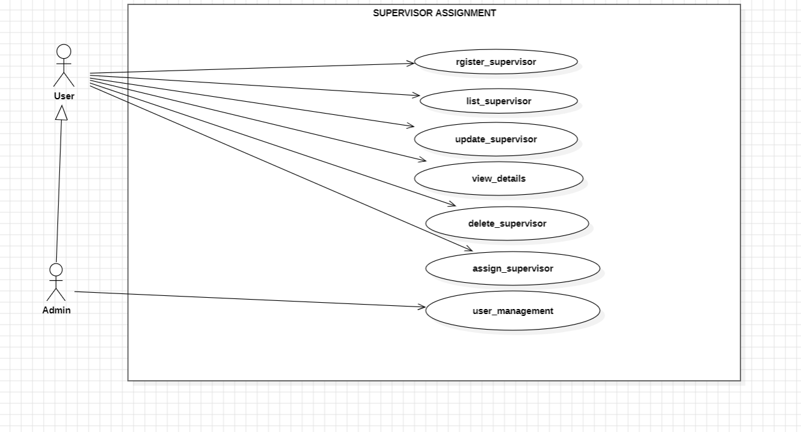
USE CASE DIAGRAMS
FIG 2: User can register, list, update, delete Supervisor and also view details about interns, while the Admin has all these privileges, it can also create new supervisors and Assign them.
FIG 1: User can register, list, update, delete interns and also view details about interns, while the Admin has all these privileges, it can also create new interns
6

Slide 7
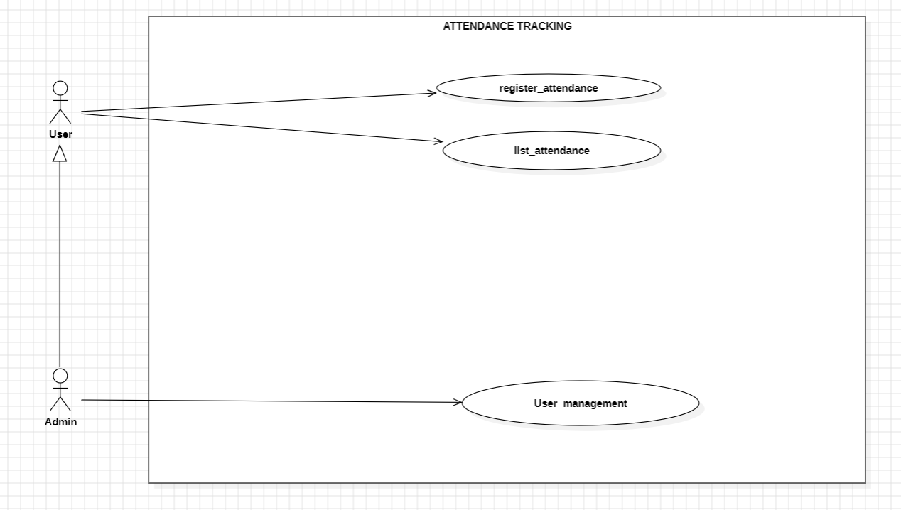
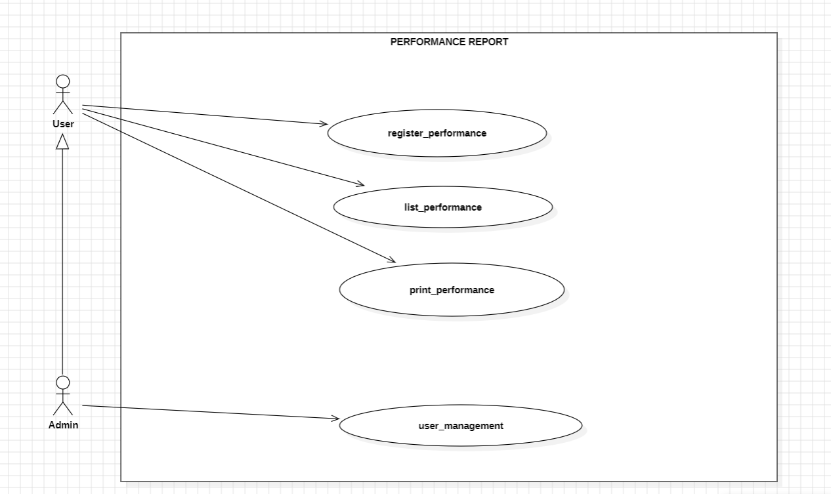
USE CASE DIAGRAMS
FIG 3: User registers attendance and list attendance, while Admin has all privileges, he can also create, delete attendance.
FIG 4: User can register, list, print performance. Admin can create performance, delete and also carry out all privileges as the User
7

Slide 8
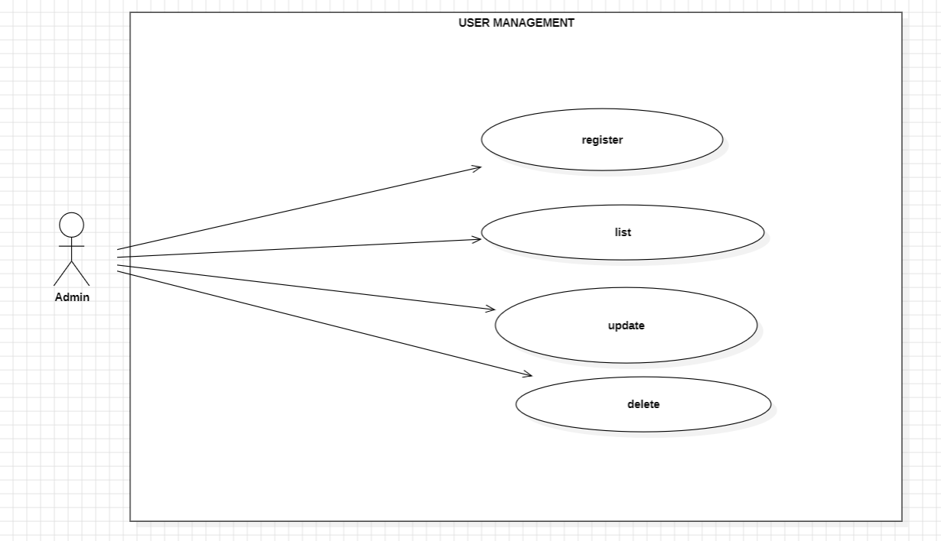
USE CASE DIAGRAMS
FIG 5: Admin can register/create, delete, update, list users
8

Slide 9
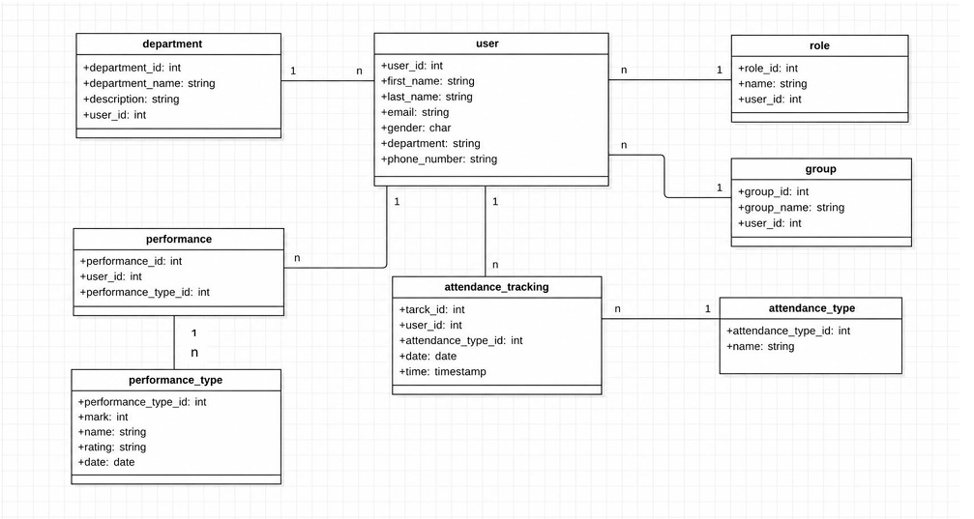
CLASS DIAGRAM
9
9

Slide 10

Key Engineering Advantage
Zero Server Overhead & Maximum Privacy
InternFlow runs entirely within the client's browser using IndexedDB — requiring zero remote server infrastructure or subscription hosting costs.
100%
Key Advantages:
Client-Side Power
•
Offline Capability: Operates reliably even when internet connectivity drops.
•
Data Privacy: All sensitive intern records remain securely stored on the device.
•
Instant Response: Zero network latency for fast data queries and report generation.
10
10

Slide 11


End-to-End System Workflow
2. Registration
4. Evaluate & Print
1. Login & Auth
Interns & Supervisors registered into IndexedDB with bio records.
3. Grouping
Daily attendance tracked; performance reports generated & printed.
Admin signs into the portal and sets up user roles & permissions.
Interns assigned into groups and linked to supervisor profiles.
11

Slide 12




System Features Overview
Built for Efficiency
Features include single-click intern creation, dynamic supervisor assignment, automated attendance verification, and instant print-ready performance reports.
InternFlow provides a modern, clean interface for administrators and team leads at PRESPRINT PLC.
Assign Groups & Departments and
Full Delete & Management
12

Slide 13


Agile Execution & Team Workflow
Project Management via Jira
Project Outcomes
We utilized Jira to streamline development and ensure accountability:
Key achievements from the project delivery:
•
Eliminated manual logbooks at PRESPRINT PLC.
•
Tasks split into discrete modules (UI, Database, Logic, Diagrams).
•
Demonstrated full software lifecycle from UML to browser deployment.
•
Daily sprint tracking for continuous progress and bug resolution.
•
Extensible architecture ready for future cloud sync or biometric integration.
•
Equitable work distribution among all team members.
13

Slide 14

Live System Demonstration
We will now walk you through the live InternFlow software, showcasing Login, Intern Onboarding, Group Assignment, Attendance Tracking, and Performance Reporting.
14

Slide 15

Questions & Discussion
Thank you for your time and attention!
GROUP 1 PROJECT DEFENSE
Ngene Brandon | Ngefor Marion | Nchang Vigiline
PDL Department | PRESPRINT PLC
15

